Slide 1
Hamcrest
Anagram of “Matchers”

Slide 2
What is Hamcrest?
http://hamcrest.org/
http://code.google.com/p/hamcrest/wiki/Tutorial
http://junit.sourceforge.net/doc/cookbook/cookbook.htm
http://hamcrest.org/JavaHamcrest/javadoc/1.3/

Slide 3
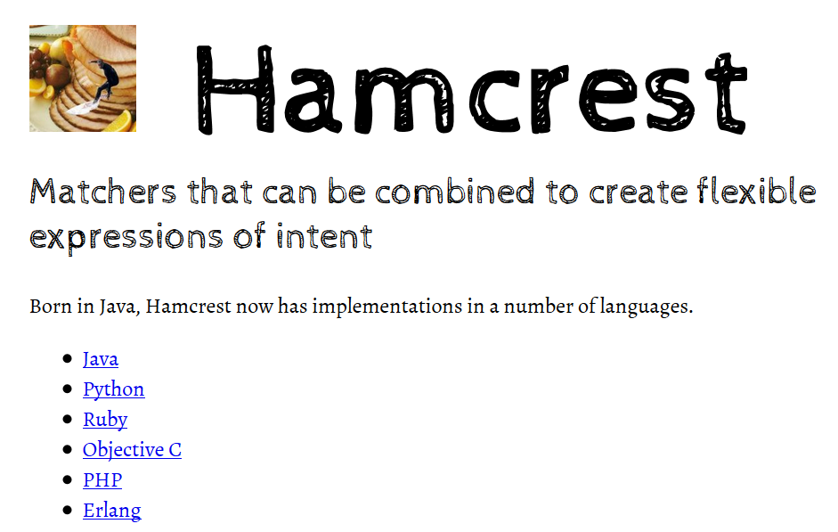

Slide 4
Download
Same way we added Selenium in IntelliJ using Maven
http://central.maven.org/maven2/org/hamcrest/hamcrest-all/1.3/hamcrest-all-1.3.jar

Slide 5
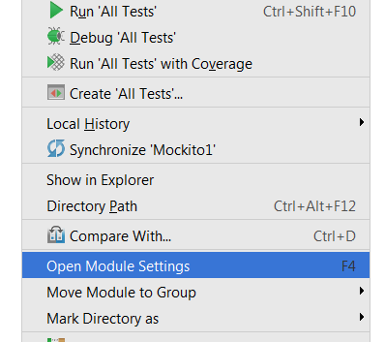
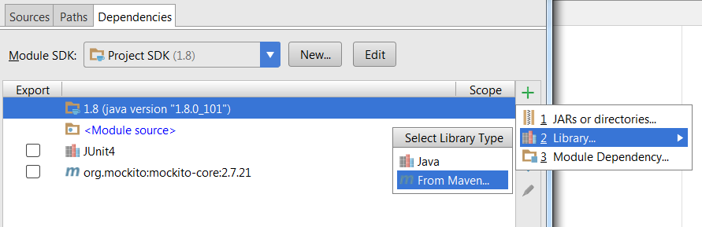
IntelliJ Setup

Slide 6
Hamcrest is a framework for writing matcher objects allowing 'match' rules to be defined declaratively.
There are a number of situations where matchers are invaluable, such as UI validation, or data filtering,
But it is in the area of writing flexible tests that matchers are most commonly used.

Slide 7
My first Hamcrest test
import static org.hamcrest.MatcherAssert.assertThat; import static org.hamcrest.Matchers.*; @Test public class BiscuitTest { public void testEquals() { Biscuit theBiscuit = new Biscuit("Ginger"); Biscuit myBiscuit = new Biscuit("Ginger"); assertThat(theBiscuit, equalTo(myBiscuit)); } }

Slide 8
If you have more than one assertion in your test you can include an identifier for the tested value in the assertion:
assertThat("chocolate chips", theBiscuit.getChocolateChipCount(), equalTo(10));
assertThat("hazelnuts", theBiscuit.getHazelnutCount(), equalTo(3));

Slide 9
Hamcrest Common Matchers
A tour of Hamcrest comes with a library of useful matchers. Here are some of the most important ones.
Core
anything - always matches, useful if you don't care what the object under test is
describedAs - decorator to adding custom failure description
is - decorator to improve readability - see "Sugar", below
Logical
allOf - matches if all matchers match, short circuits (like Java &&)
anyOf - matches if any matchers match, short circuits (like Java ||)
not - matches if the wrapped matcher doesn't match and vice versa

Slide 10
Object
equalTo - test object equality using Object.equals
hasToString - test Object.toString
instanceOf, isCompatibleType - test type
notNullValue, nullValue - test for null
sameInstance - test object identity
Beans
hasProperty - test JavaBeans properties

Slide 11
Collections
array - test an array's elements against an array of matchers
hasEntry, hasKey, hasValue - test a map contains an entry, key or value
hasItem, hasItems - test a collection contains elements
hasItemInArray - test an array contains an element
Number
closeTo - test floating point values are close to a given value
greaterThan, greaterThanOrEqualTo, lessThan, lessThanOrEqualTo - test ordering

Slide 12
Text
equalToIgnoringCase - test string equality ignoring case
equalToIgnoringWhiteSpace - test string equality ignoring differences in runs of whitespace
containsString, endsWith, startsWith - test string matching

Slide 13
Syntactic Sugar
Hamcrest strives to make your tests as readable as possible.
For example, the “is” matcher is a wrapper that doesn't add any extra behavior to the underlying matcher., but increases readability.
The following assertions are all equivalent:
assertThat(theBiscuit, equalTo(myBiscuit));
assertThat(theBiscuit, is(equalTo(myBiscuit)));
assertThat(theBiscuit, is(myBiscuit));
The last form is allowed since is(T value) is overloaded to return is(equalTo(value)).

Slide 14
Writing custom matchers
matcher for testing if a double value has the value NaN (not a number). This is the test we want to write:
public void testSquareRootOfMinusOneIsNotANumber() { assertThat(Math.sqrt(-1), is(notANumber())); }

Slide 15
isNotANumber Implementation
package org.hamcrest.examples.tutorial; import org.hamcrest.Description; import org.hamcrest.Factory; import org.hamcrest.Matcher; import org.hamcrest.TypeSafeMatcher;

Slide 16
public class IsNotANumber extends TypeSafeMatcher<Double> { @Override public boolean matchesSafely(Double number) { return number.isNaN(); } public void describeTo(Description description) { description.appendText("not a number"); } @Factory public static <T> Matcher<Double> notANumber() { return new IsNotANumber(); } }

Slide 17
assertThat(1.0, is(notANumber()));
fails with the message
java.lang.AssertionError: Expected: is not a number got : <1.0>

Slide 18
// Generated source
package org.hamcrest.examples.tutorial; public class Matchers { public static <T> org.hamcrest.Matcher<T> is(T param1) { return org.hamcrest.core.Is.is(param1); } public static <T> org.hamcrest.Matcher<T> is(java.lang.Class<T> param1) { return org.hamcrest.core.Is.is(param1); } public static <T> org.hamcrest.Matcher<T> is(org.hamcrest.Matcher<T> param1) { return org.hamcrest.core.Is.is(param1); } public static <T> org.hamcrest.Matcher<java.lang.Double> notANumber() { return org.hamcrest.examples.tutorial.IsNotANumber.notANumber(); } }

Slide 19
Update test to use the new Matchers class
import static org.hamcrest.MatcherAssert.assertThat; import static org.hamcrest.examples.tutorial.Matchers.*; import junit.framework.TestCase; public class CustomSugarNumberTest extends TestCase { public void testSquareRootOfMinusOneIsNotANumber() { assertThat(Math.sqrt(-1), is(notANumber())); } }

Slide 20
import static org.junit.Assert.*;
import static org.hamcrest.CoreMatchers.*;
public class Junit4FeaturesTest {
@org.junit.Test
public void testArrays() {
assertThat(new Integer[] {1,2,3,4,5}, equalTo(new Integer[]{1,2,3,4,5}));
assertThat(new Integer[] {1,2,3,4,5}, not(new Integer[] {1,2}));
}
}

Slide 21
import static org.junit.Assert.*;
import static org.hamcrest.Matchers.*;
import org.junit.Test;
public class Junit4FeaturesTest {
@Test public void testNumericComparison() { assertThat(1,lessThan(2)); assertThat(2,greaterThan(1));
assertThat(2,greaterThanOrEqualTo(2)); assertThat(1,lessThanOrEqualTo(1));

Slide 22
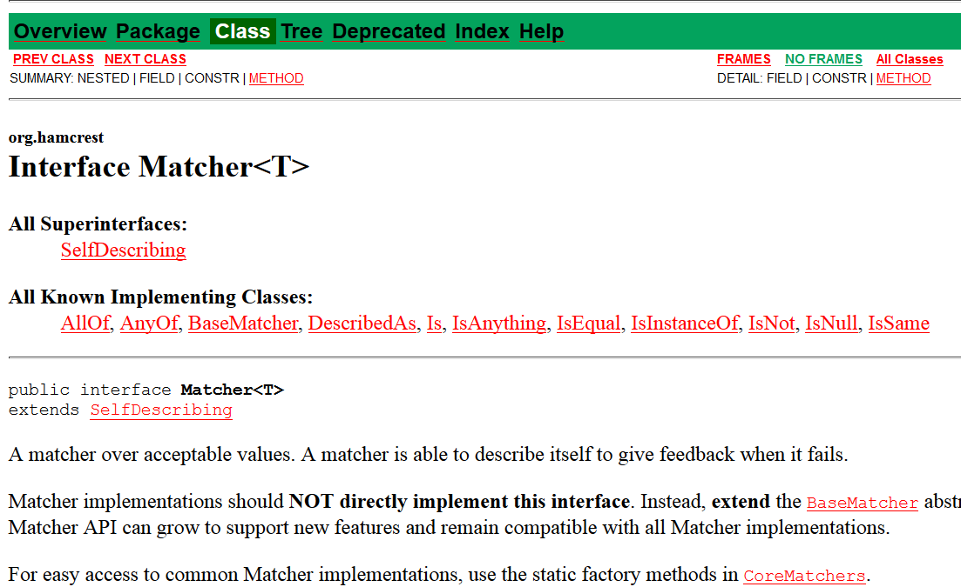
Hamcrest API

Slide 23
http://hamcrest.org/JavaHamcrest/javadoc/1.3/
org.hamcrest Interface Matcher<T>
All Superinterfaces: SelfDescribing
All Known Implementing Classes: AllOf, AnyOf, BaseMatcher, BigDecimalCloseTo, CombinableMatcher, CustomMatcher, CustomTypeSafeMatcher, DescribedAs, DiagnosingMatcher, Every, FeatureMatcher, HasProperty, HasPropertyWithValue, HasToString, HasXPath, Is, IsAnything, IsArray, IsArrayContaining, IsArrayContainingInAnyOrder, IsArrayContainingInOrder, IsArrayWithSize, IsCloseTo, IsCollectionContaining, IsCollectionWithSize, IsCompatibleType, IsEmptyCollection, IsEmptyIterable, IsEmptyString, IsEqual, IsEqualIgnoringCase, IsEqualIgnoringWhiteSpace, IsEventFrom, IsIn, IsInstanceOf, IsIterableContainingInAnyOrder, IsIterableContainingInOrder, IsIterableWithSize, IsMapContaining, IsNot, IsNull, IsSame, OrderingComparison, SamePropertyValuesAs, SamePropertyValuesAs.PropertyMatcher, StringContains, StringContainsInOrder, StringEndsWith, StringStartsWith, SubstringMatcher, TypeSafeDiagnosingMatcher, TypeSafeMatcher

Slide 24
Mockito and matchers
You can use matchers in Mockito
Mockito also has its own matchers
Checkout intThat() method in Mockito

